Slide 1

Fall 2024 :: CSCE 636 :: Deep Learning
Improving CLIP Training
Omar Khater & Michael Norman

Slide 2
Introduction
Context:
Contrastive learning has enabled breakthroughs in multimodal models like CLIP but struggles with batch-size sensitivity and slow convergence.
Goal:
Improve multimodal learning by optimizing global contrastive loss functions to overcome these limitations.
These methods aim to provide more robust feature learning and improved generalization across multimodal tasks.

Slide 3
Contributions
Explore global loss functions, including state-of-the-art techniques such as SogCLR and iSogCLR, alongside their optimizations.
Investigate the effectiveness of Bayesian optimization and advanced optimizers, such as AdamW, RAdam in improving the convergence and performance of these global losses.

Slide 4
Background
Contrastive Learning
Aligns embeddings of similar pairs (e.g., image-text) while separating dissimilar ones.
However, local losses rely on mini-batches, leading to limited negative sampling.
Global Contrastive Loss
Leverages dataset-wide negatives for better convergence and representation quality.
SogCLR
Memory efficient stochastic optimization for Global Contrastive Loss.
iSogCLR
Adds dynamic temperature learning and regularization for imbalanced datasets.

Slide 5
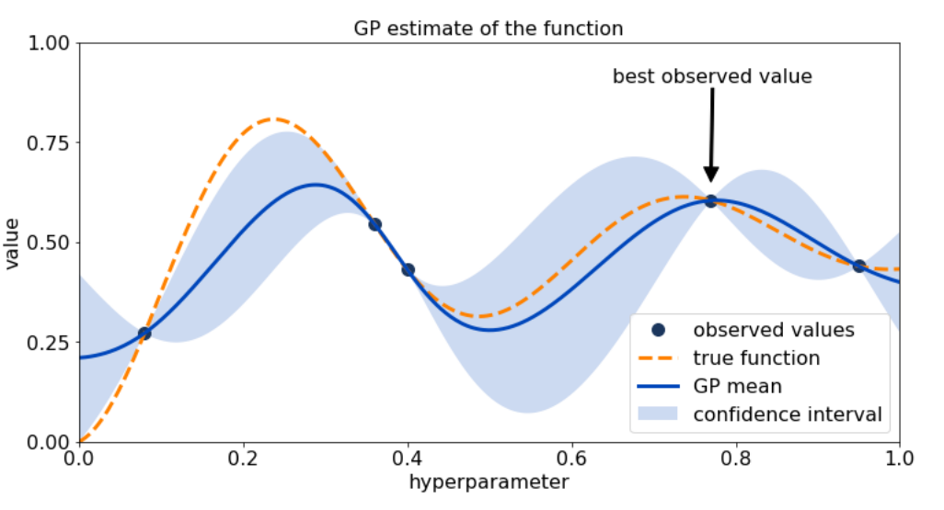
Background
Bayesian Optimization
A probabilistic model-based approach that optimizes a target function by iteratively constructing a surrogate model.
Employs acquisition functions, such as Expected Improvement (EI) or Upper Confidence Bound (UCB), to determine the next set of hyperparameters to evaluate.
Strategically narrows the search space, significantly reducing computation time while improving results.

Slide 6
Datasets and Metrics
Datasets:
MSCOCO: Large-scale image-text pairs for retrieval.
ImageNet: 1,000-category benchmark for zero-shot classification.
Metrics:
TR@1: Top-1 Text-to-Image Recall.
IR@1: Top-1 Image-to-Text Recall.
ACC@1: Zero-shot classification accuracy.

Slide 7
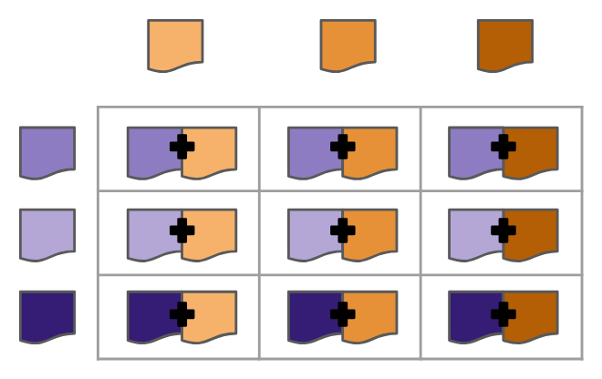
Experiment Overview
Phase 1: Initial Search
Phase 2: Grid Search
Phase 3: Bayesian Fine-Tuning
Optimizers
Top 3
Top 1
Loss
Optimizer
Loss Functions

Slide 8
Experiments - Phase 1
Goal:
Explore the search space to identify sensitivity of performance to different loss functions and optimizers.
Setup:
Search space included 3 loss functions (SogCLR, iSogCLR_New, and iSogCLR_New_v2) and 10 optimizers (AdamW, RAdam, FusedLAMB, NovoGrad, and others).
Experiments were conducted over 10 epochs on 20% of the dataset.

Slide 9
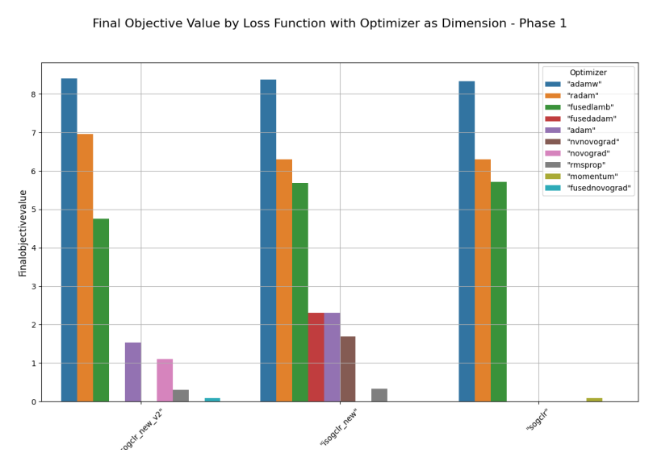
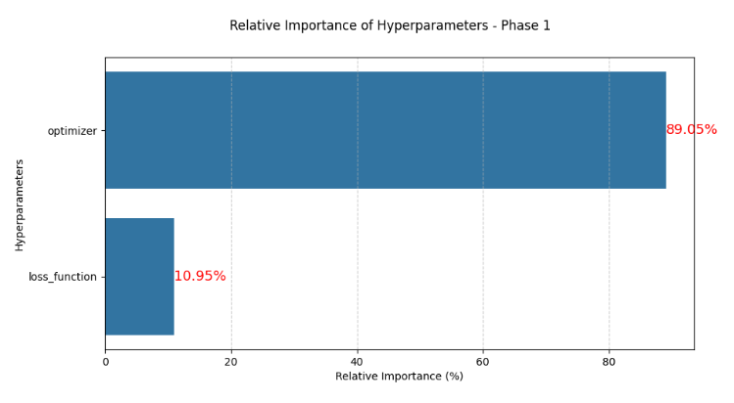
Experiments - Phase 1
Key Findings:
Optimizer choice had a greater impact (89%) than loss function choice (11%).
RAdam and AdamW consistently outperformed other optimizers.

Slide 10
Experiments - Phase 2
Goal:
Narrow the search space for the top-performing loss functions and optimizers from Phase 1 and use grid search to find the best combinations.
Setup:
Focused on three loss functions (SogCLR, iSogCLR_New, and iSogCLR_New_v2) and three optimizers (AdamW, RAdam, and FusedLAMB).
Experiments were conducted over 15 epochs on the full dataset.

Slide 11
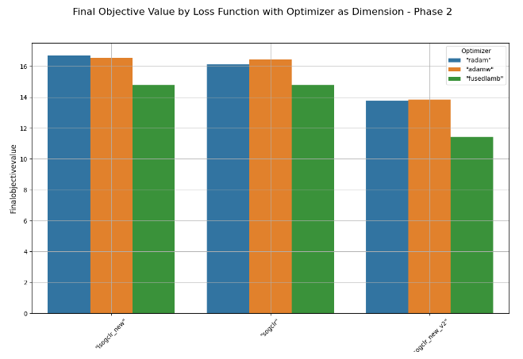
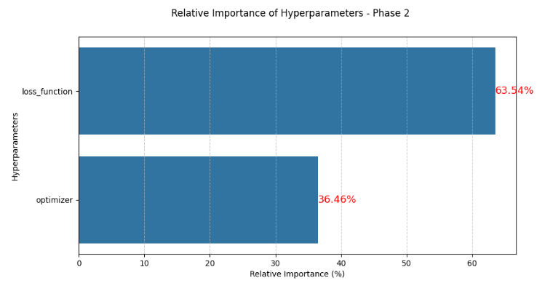
Experiments - Phase 2
Key Findings:
RAdam combined with iSogCLR_New delivered the best results.
Loss function choice had a greater impact (64%) than optimizer choice (36%).

Slide 12
Experiments - Phase 3
Goal:
Fine-tune the best-performing configuration from Phase 2 for optimal performance.
Setup:
The configuration used iSogCLR_New as the loss function and RAdam as the optimizer.
Used Bayesian optimization to to fine-tune these hyperparameters.
Key hyperparameters tuned included learning rate (lr), embedding dimension (embed_dim), and minimum learning rate (min_lr).
The model was trained for 30 epochs on the full dataset.

Slide 13
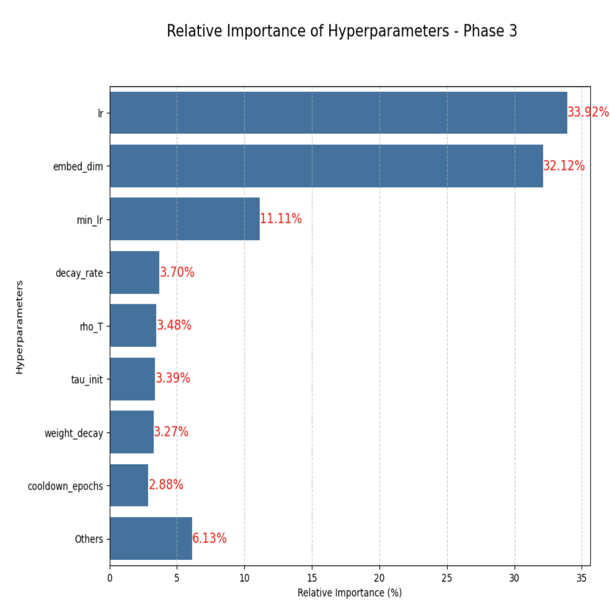
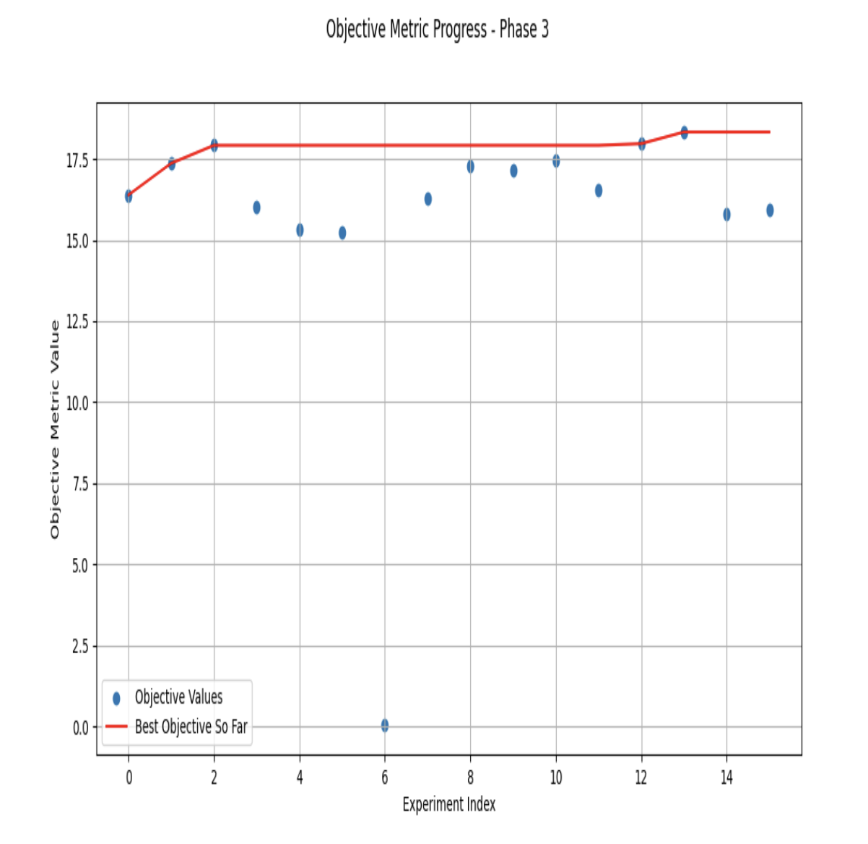
Experiments - Phase 3
Key Findings:
Learning rate (lr) and embedding dimension (embed_dim) were the most critical hyperparameters, contributing 33.92% and 32.12% to performance, respectively.
Minimum learning rate (min_lr) also played a significant role (11.11%).
Other parameters like decay rate and weight decay had smaller impacts (<4%).

Slide 14
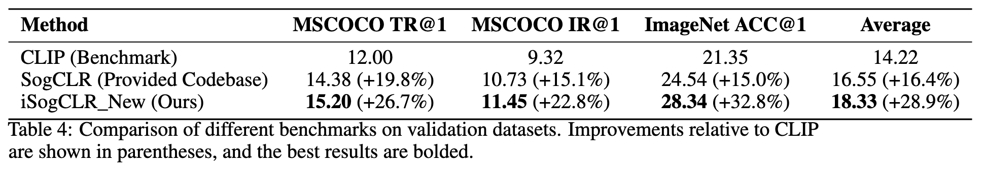
Results
Our model significantly outperforms the CLIP benchmark as well as the provided codebase for the project.
Achieved a 28.9% overall improvement over CLIP and a 16.4% improvement over SogCLR.
We find the greatest improvement on the ImageNet Accuracy over the baselines.

Slide 15
Conclusion
Findings:
Our method demonstrated superior performance in multimodal learning tasks compared to baseline models.
Key advancements include:
+26.7% improvement in TR@, +22.8% in IR@1, +32.8% in ACC@1 over CLIP
Significance:
Validates the effectiveness of global contrastive loss functions for multimodal tasks.
Bayesian optimization played a crucial role in fine-tuning key hyperparameters, enabling robust performance.

Slide 16
Thank You!

